Slide 1


Design and Implementation of a Parking Slot Detection System Using MATLAB
Presented By: M KASHI VISHWANATH
Register Number: URK23EC4015
Division of Electronics and Communication Engineering
2025-2026 (ODD SEM)
III IA EVALUATION PPT Presentation
for
DIGITAL IMAGE PROCESSING-PROJECT BASED COURSE
Subject Code 23EC2011

Slide 2
Introduction
This project focuses on the design and implementation of a Parking Slot Detection System , a cost-effective and scalable alternative to expensive in-ground sensor technologies. The system is developed entirely within the MATLAB environment, leveraging its powerful Image Processing and Computer Vision Toolboxes to analyze parking lot images.
The primary goal is to create a user-friendly application that can automatically process an image of a parking lot, identify predefined parking spaces, and classify each space as either "Occupied" or "Empty." By creating an interactive graphical user interface (GUI), the system provides an intuitive platform for users to load images, define parking areas, and receive immediate visual and statistical feedback on parking availability, demonstrating a practical application of image analysis for real-world problem-solving.

Slide 3
Project Objectives
This project involves the creation of a standalone desktop application, "Parking Slot Detection System (Pro)," using MATLAB's App Designer. The application provides a complete graphical user interface (GUI) for monitoring parking lot occupancy through computer vision. It allows a user to load an image of a parking area, define the locations of individual parking slots, and run an automated analysis to classify each slot as either occupied or empty. The system then presents the results in a clear, multi-faceted dashboard, complete with visual overlays, summary statistics, and a graphical chart.
Setup Phase: Load Image
Detection Phase: Run Analysis, Classification
Reporting Phase: Visual Feedback, Data Dashboard, Export

Slide 4
Concept Involved
Region of Interest (ROI) Definition:
The system is told exactly where to look by defining rectangular boxes over each parking slot.
Analogy: Highlighting specific sentences on a page to focus only on them.
Feature Extraction (Edge Density):
The system calculates a numerical feature to describe the content of each box.
Empty Slot: Smooth asphalt = Low edge density.
Occupied Slot: A car has many contours = High edge density.
Classification via Thresholding:
A simple rule is applied: IF (Edge Density > Threshold) THEN Mark as 'Occupied'.
The user can adjust this threshold with a slider to fine-tune sensitivity.

Slide 5

Tools and Technologies Used
MATLAB R2023b (or similar): The core programming environment.
MATLAB App Designer:
Used to visually design and build the entire interactive GUI with buttons, sliders, axes, and panels.
Image Processing Toolbox™:
Provides fundamental functions for the detection algorithm, including:
rgb2gray: Image conversion.
edge: Canny edge detection.
imclose, strel: Morphological operations to refine the edge map.
imcrop: To isolate each parking slot (ROI).
Computer Vision Toolbox™:
Provides the framework and functions for displaying visual annotations like rectangles and text labels on the image.

Slide 6
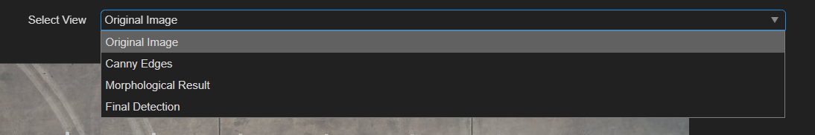
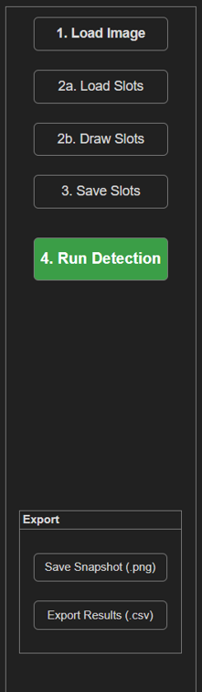
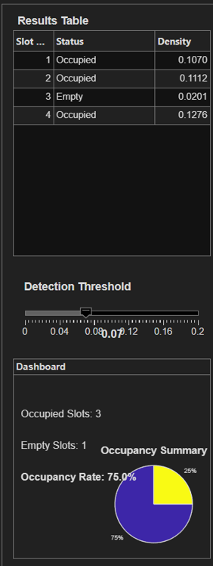
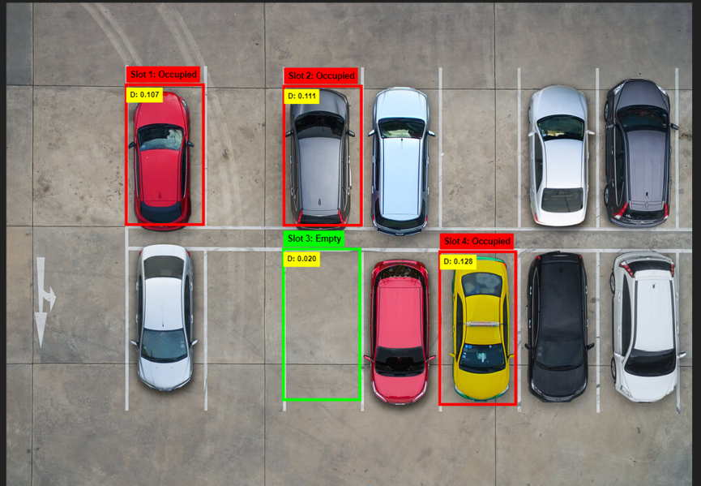
System Workflow & Implementation
Load Image: User selects a parking lot image.
Define Slots: User draws rectangles for each slot or loads a saved configuration file.
Run Detection: The user initiates the analysis.
Image Processing Pipeline:
Convert Image to Grayscale.
Apply Canny Edge Detector.
Perform Morphological Closing to clean the image.
Per-Slot Analysis:
For each slot, crop the processed image.
Calculate Edge Density ('D' value).
Compare density to the threshold and classify as "Occupied" or "Empty".
Display Results: Update the GUI with visual overlays, data tables, and the pie chart.

Slide 7
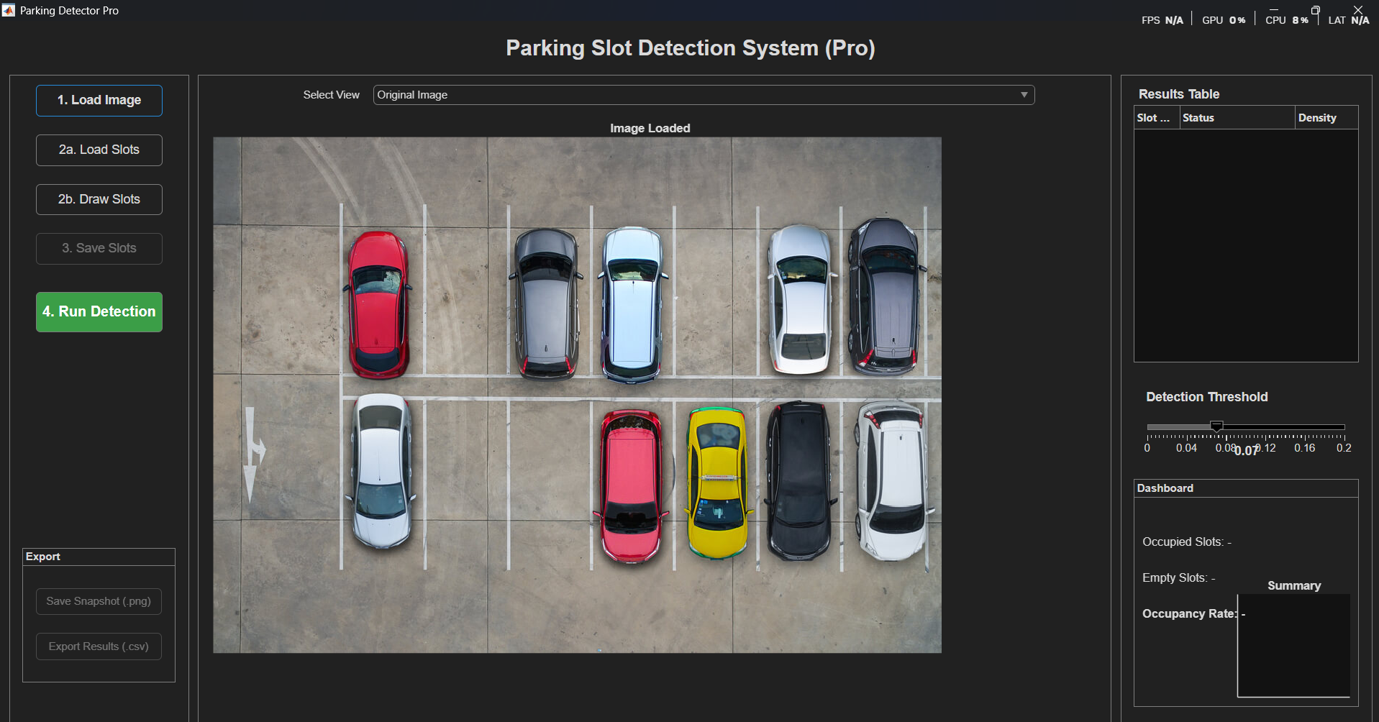
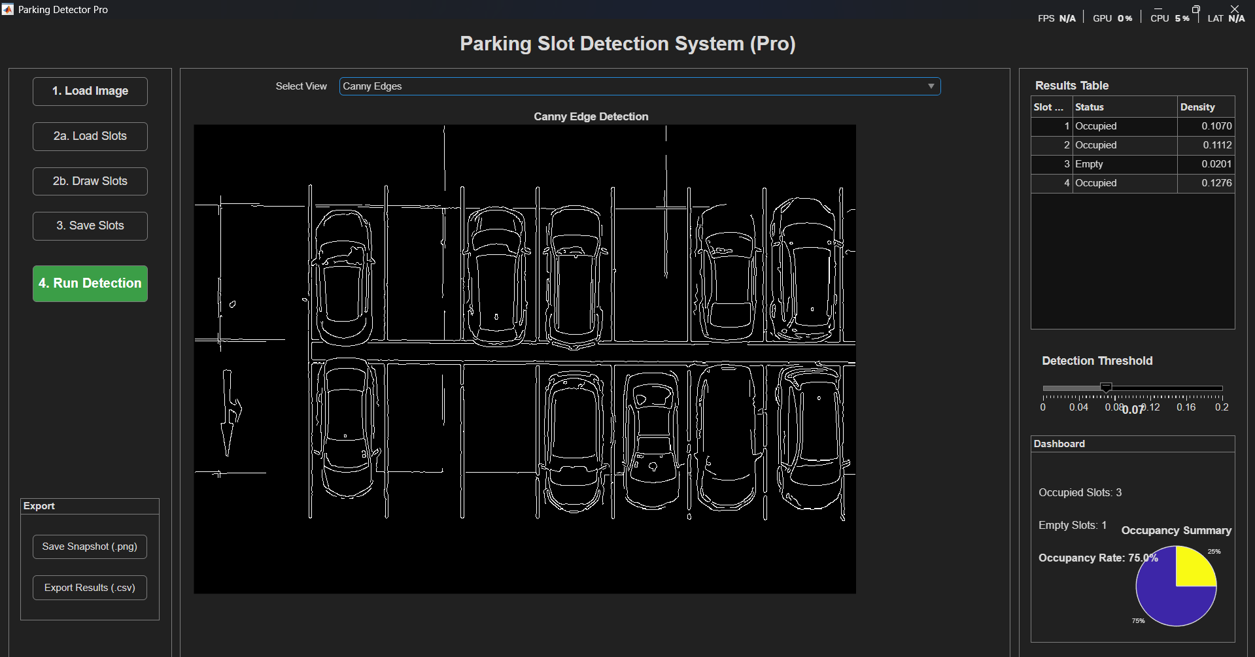
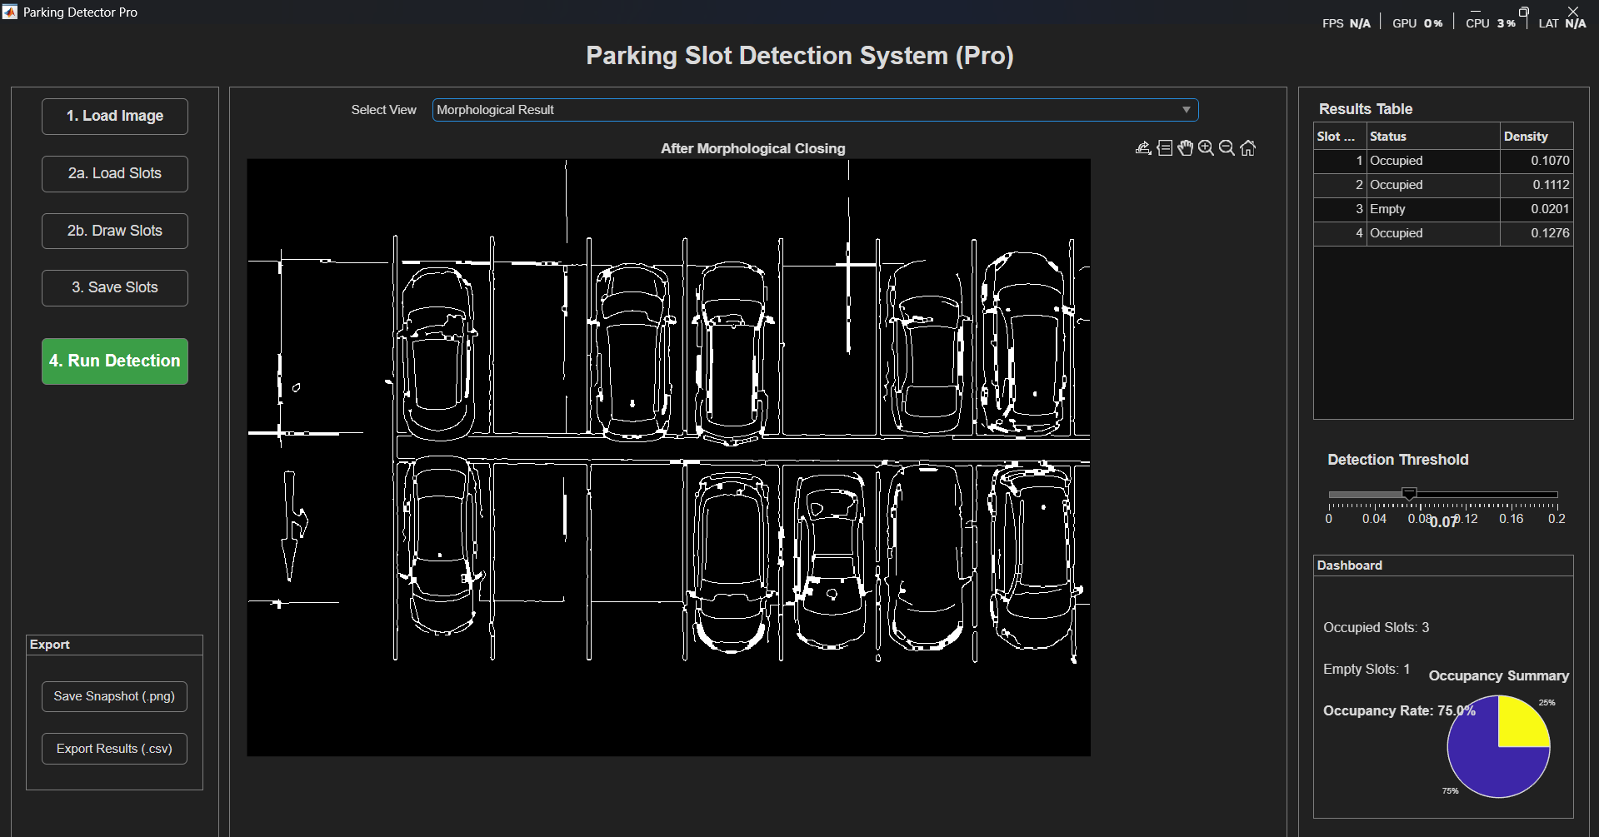
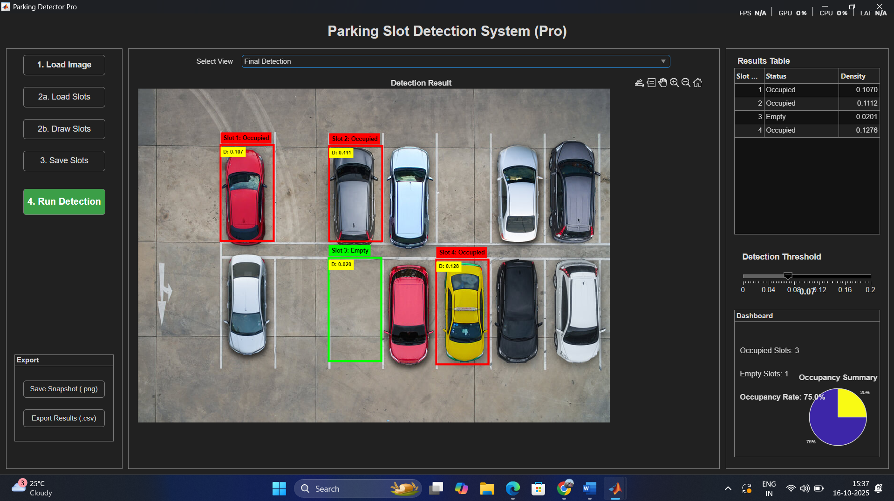
Results - Visual Simulation
1 Original Image
2 Canny Edge Detection
3 Morphological Process
4 Final Detection

Slide 8
Results - Dashboard & Analytics
The right-hand panel provides a quantitative summary of the detection.
Results Table: Lists the status and density for every individual slot.
Summary Statistics: Displays the total count of occupied/empty slots and the overall Occupancy Rate %.
Occupancy Pie Chart: A graph that provides an instant visual summary of the parking lot's availability.
Image: [Use the same screenshot, but you can draw a box highlighting the right-hand panel to draw attention to it.]

Slide 9
Conclusion
This project successfully created a functional and user-friendly parking detection system in MATLAB. The application effectively combines image processing techniques with an interactive GUI to solve a real-world problem. While the current algorithm performs well in consistent conditions, its main limitation is its vulnerability to environmental variations like shadows and lighting changes. The system serves as an excellent foundation for a more advanced, robust smart parking solution.

Slide 10
THANK YOU

